Slide 1
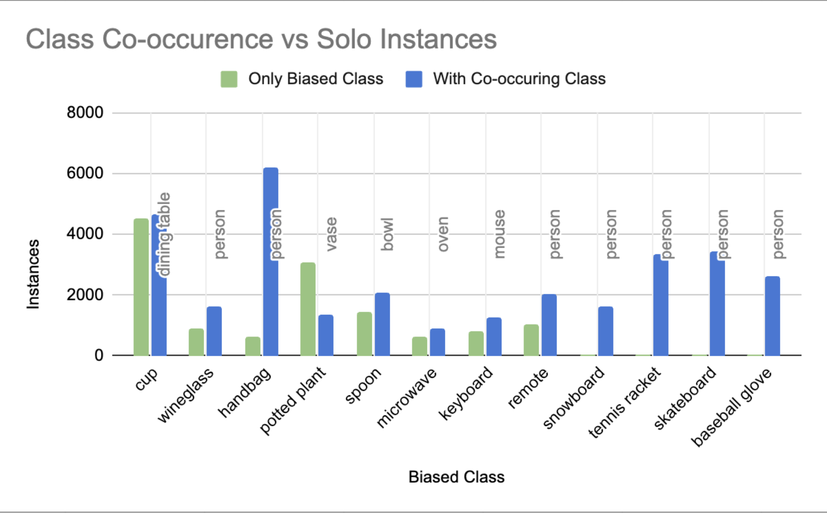
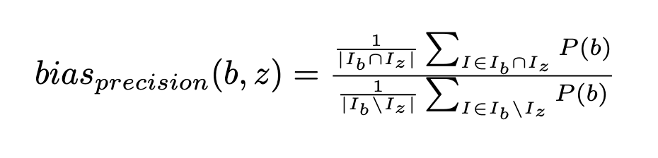
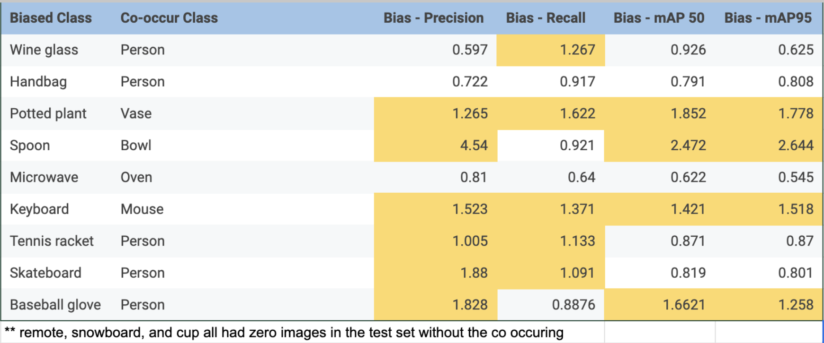
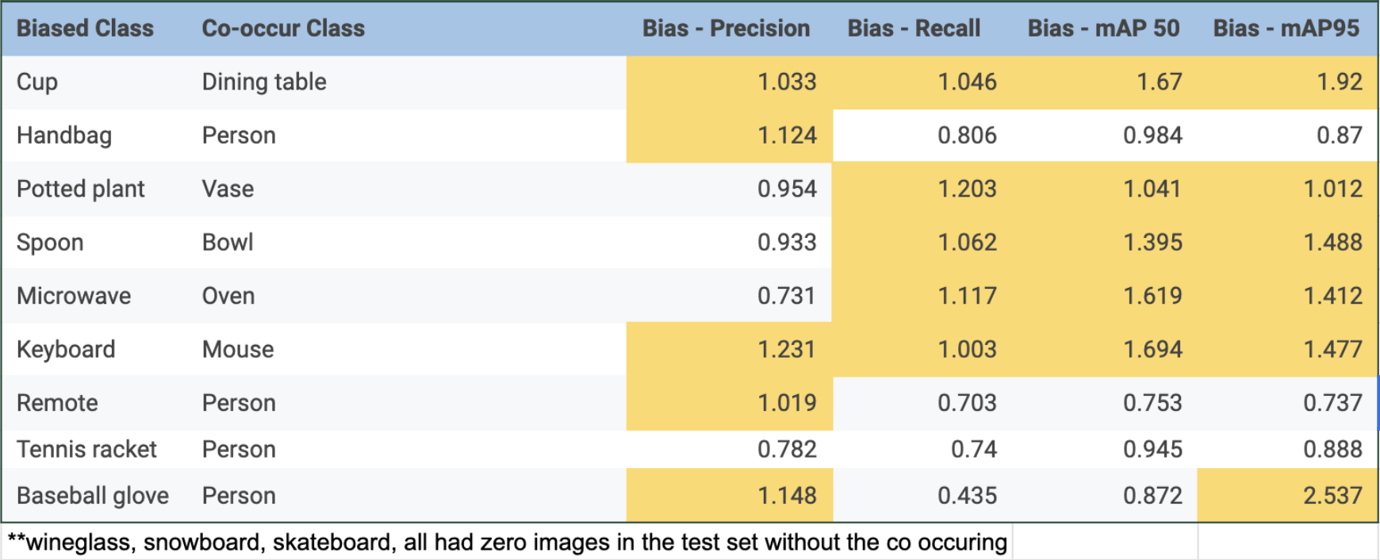
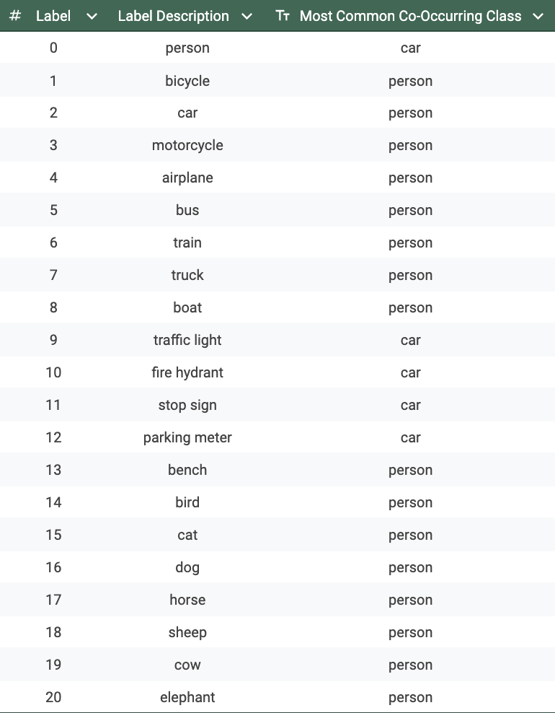
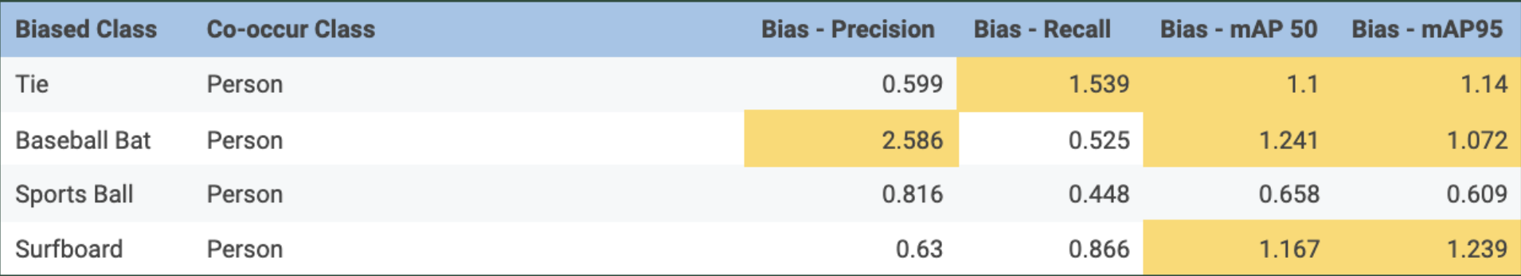
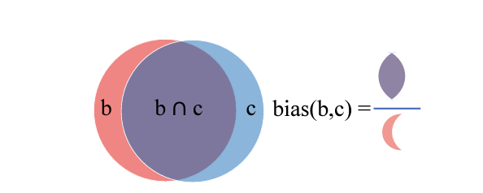
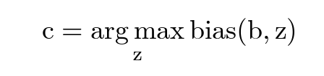
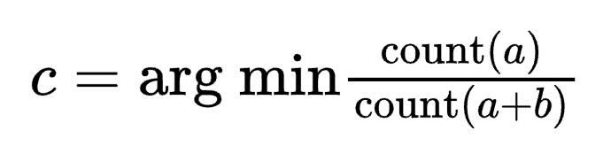
Analyzing Co-Occurring Bias in YOLOV5
Guanyi Cao, Tara Shukla, Molly Taylor
COS429: Computer Vision, Princeton University
Background
Visual context, the surrounding elements in an image, helps models identify objects of interest – but they also lead to contextual bias.
Contextual bias causes a model to rely on an object’s surroundings rather than the object itself, i.e., recognizing a skateboard only when a person is present. Models may also "hallucinate" objects in correlated contexts (e.g. detecting a microwave in a kitchen where there is none). This reduces model credibility and creates significant real-world challenges.
Singh et al. evaluate contextual bias in object classification, and we investigate contextual bias in object detection.
Figure 1: Visualization of co-occurrences from training on the COCO dataset
System Implementation
Data Processing
Convert Open Images test set to YOLO format
Build test sets to evaluate performance on co-occurring pairs
Validate model on both datasets to get performance metrics (precision/recall maps) on commonly co-occurring class pairs.
Calculate bias for co-occurring pairs (across P/R/map50/map95)
Identify new class-pairs where one object occurs frequently with another in COCO train and determine the most commonly occurring co-occurring class for each class.
Objectives
Investigate co-occurring bias in the YOLOv5 object detection model, on COCO and Open Images datasets
Specifically:
Analyze model performance on class-pairs that were found to be commonly co-occurring by Singh et al.
Identify additional co-occurring pairs in COCO train set.
Calculate bias on co-occurring class-pairs.
Key Findings
After evaluating YOLOv5 on the COCO validation set and Open Images test set, we find that the model is indeed impacted by co-occurring bias.
Based on frequency of occurrence, we determined the most commonly co-occurring class for each of the 80 classes in the COCO training dataset.
Analysis:
“Person” is the most commonly occurring class for 63.75% of the 80 classes in COCO
Contextual co-occurrence:
Traffic light, fire hydrant, stop sign, parking meter → car
Wine glass, fork, knife, bowl → dining table
Open Image Co-Occurrence Bias
High Bias:
Open Images: Spoon+Bowl, Potted plant + vase
COCO: Baseball glove + person
Highest mAP95 bias, indicating model depends heavily on contextual cues
Consistent Bias: Person-related objects:
Open Images: Wine glass, handbag, tennis racket, skateboard, baseball glove
COCO: handbag, remote, tennis racket, baseball glove
COCO Co-Occurrence Bias
Most Common Co-Occurring Classes (COCO)
COCO Biases — Our Co-Occurrence Pairs
Initial Co-Occurrence Pairs Definition: COCO-STUFF [1]
Our Co-Occurrence Pairs Definition: COCO
Future Work:
Explore fine-tuning approaches that would improve the model’s ability to detect an object in the absence of its co-occurring object.
Build datasets that better represent co-occurring objects out of context.
Bias definition visualization [1]
Where b is the most frequently co occurring class with a
References: K. K. Singh, D. Majahan, K. Grauman, Y. J. Lee, M. Feiszli and D. Ghadiyaram. (2020). Don't Judge an Object by Its Context: Learning to Overcome Contextual Bias. 2020 IEEE/CVF Conference on Computer Vision and Pattern Recognition (CVPR), https://arxiv.org/abs/2001.03152

